Slide 1
Weekly report: Foundations
Week number: 06
Date: 29/10/2025
Supervisor: Prof. Dr.-Ing. Torsten Faber
Group members : Jehad Albaali- Amgad Gerges - Reda Deif
presented by : Jehad Albaali

Slide 2
List of contents
Introduction & Objectives
Input Data (Loads, Materials, Geometry)
Stability Check Overturning
Stability Check : Bearing Capacity
Stability Check : Sliding
Summary of Results & Conclusion
Next Steps
Jehad Albaali
Foundations team/ Optimus Syria

Slide 3
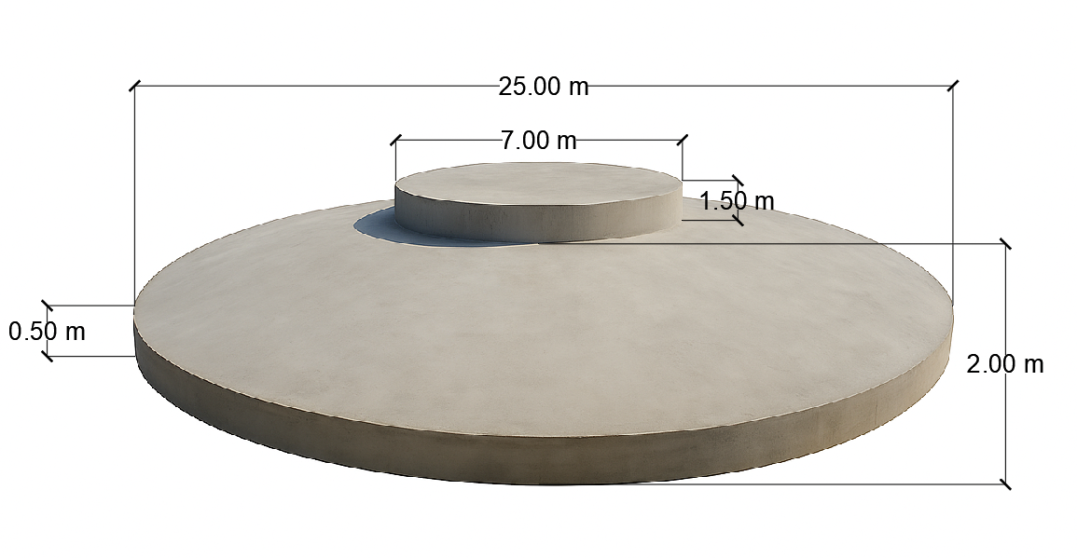
Concrete Dimensions
Diameter of Base Plate (BP) = 25 m
Diameter of Pedestal = 7 m
Height Pedestal = 1.5 m
Height of Middle slab = 2 m
Height of Frustum (HF) = 1.5 m
Height of Edge slab (HE) = 0.5 m
Jehad Albaali
Foundations team/ Optimus Syria

Slide 4
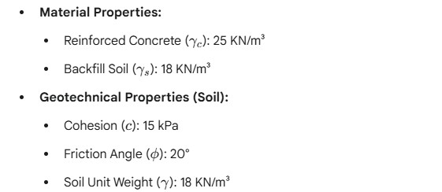
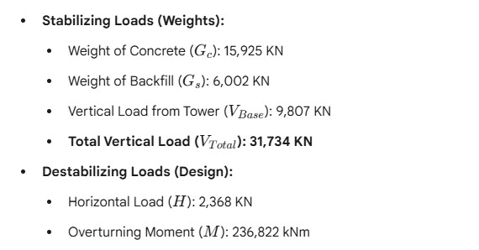
input Data
Jehad Albaali
Foundations team/ Optimus Syria

Slide 5
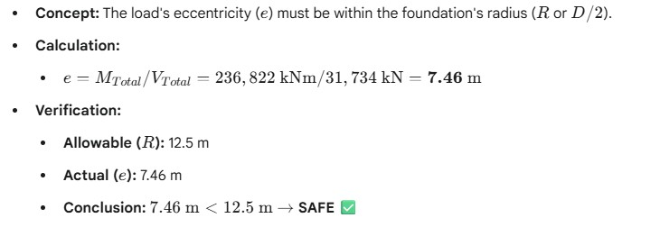
Overturning Check
Group members: Jehad Albaali- Amgad Gerges - Reda Deif
Foundations team/ Optimus Syria

Slide 6
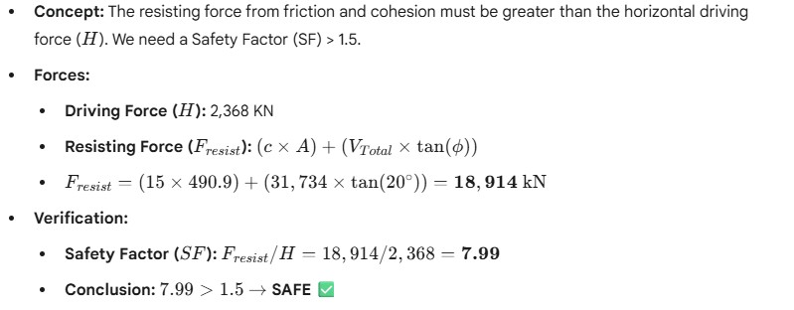
Sliding Check
Jehad Albaali
Foundations team/ Optimus Syria

Slide 7
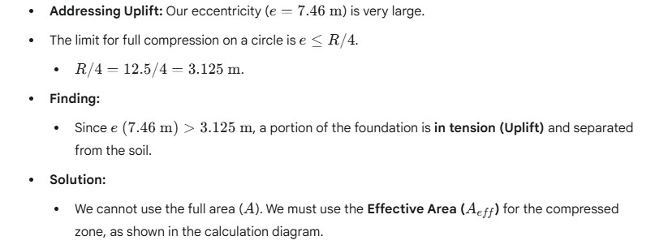
Bearing Capacity (Uplift Concept)
Jehad Albaali
Foundations team/ Optimus Syria

Slide 8
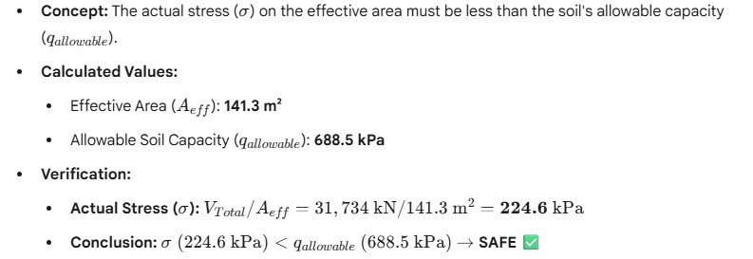
Bearing Capacity (Result)
Jehad Albaali
Foundations team/ Optimus Syria

Slide 9
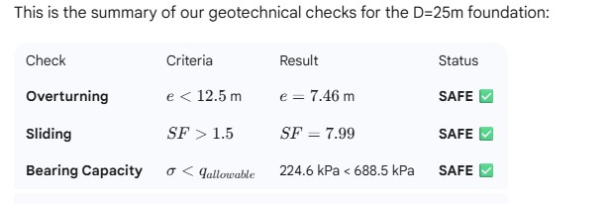
Summary of Verifications
Jehad Albaali
Foundations team/ Optimus Syria

Slide 10
Next Task
Design of Raft for bending moment
Design of Raft for shear
Design of Raft for fatigue loading
Group members: Jehad Albaali- Amgad Gerges - Reda Deif
Foundations team/ Optimus Syria

